Slide 1
Final Project HR Analytics: Job Change of Data Scientists
Mohammad Ramadhan Akbar
(JCDS-0506 BDG)

Slide 2
Project Brief Description
Human resources (HR) is the division of a business that is charged with finding, screening, recruiting, and training job applicants, as well as administering employee-benefit programs.
So in this project I use HR data set from a big company to take insight and design a simple machine learning model, so they can predict who will try to leave their job after completing their course and stay to work at the company.

Slide 3
Project Brief Description (Cont.)
Project Objectives
Create and choose one of several machine learning models, to who will move to a new job.
Create a web application using the flask, from a model that was created and selected previously.

Slide 4
Dataset Information
Dataset Source : Kaggle.com
Dataset Info :
https://www.kaggle.com/arashnic/hr-analytics-job-change-of-data-scientists
Total Rows : ± 19.158 rows
Total Features / Columns : 14 features
Total Features Used (Model & Web App) : 9 features

Slide 5
Features / Columns Desc.
enrollee_id : Unique ID for candidate
city : City code
city_ development _index : Development index of the city (scaled)
gender : Gender of candidate
relevent_experience : Relevant experience of candidate
enrolled_university : Type of University course enrolled if any
education_level : Education level of candidate
major_discipline :Education major discipline of candidate
experience : Candidate total experience in years
company_size : No of employees in current employer's company
company_type : Type of current employer
lastnewjob : Difference in years between previous job and current job
training_hours : training hours completed
target : 0 – Not looking for job change,
1 – Looking for a job change

Slide 6
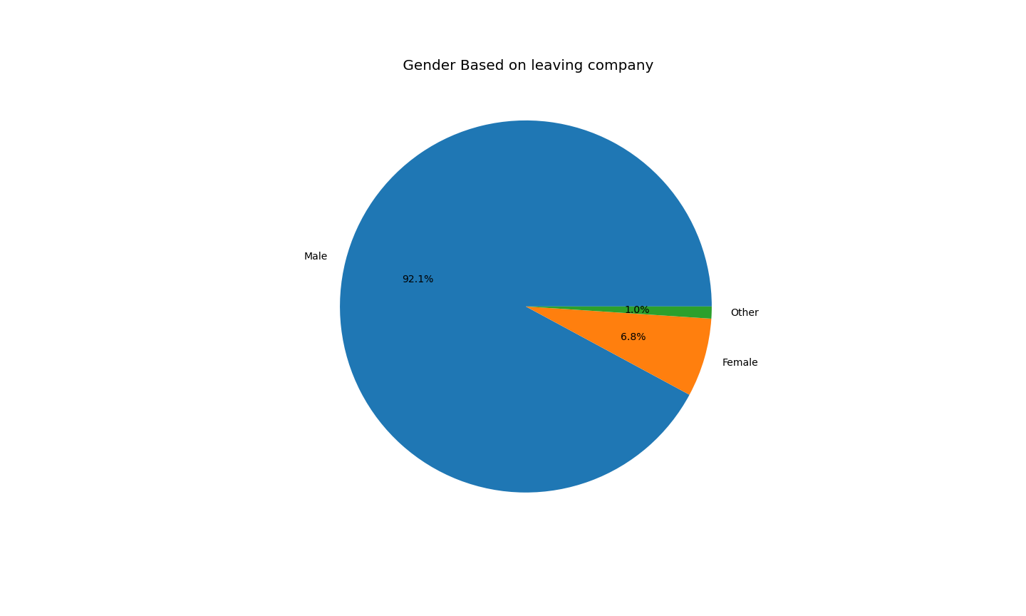
Data insights (Cont.)
We can see that male have more tendency to leave and searching for change job,
this happend because the data distribution is biased to male.
Since male more common in this dataset.

Slide 7
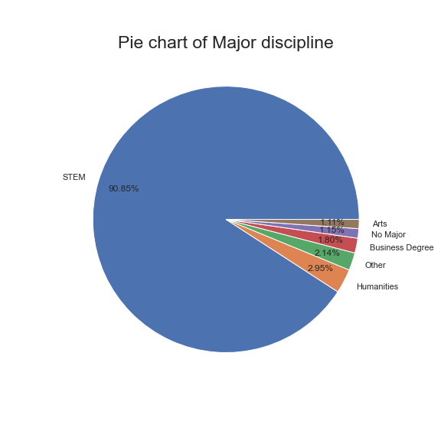
Data insights (Cont.)
STEM Major take the majority of the pie chart, this probably happened because STEM is the acronym of Science, technology, engineering, and mathematics and Data Science is evolve around Mathematic and Science

Slide 8
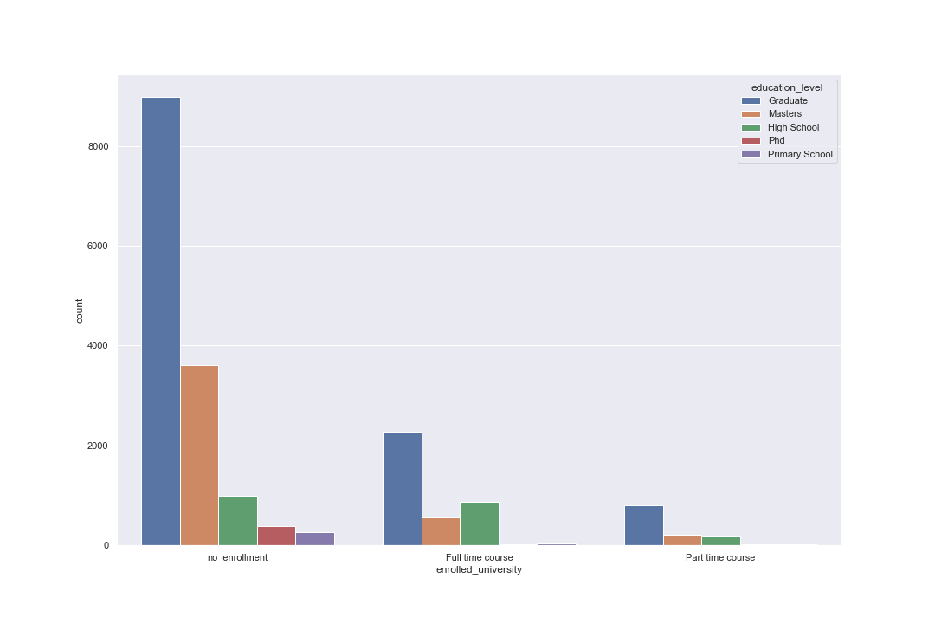
Data insights (Cont.)
based on chart above we can see that based on education level,
the most people who are not taking course are gradute and poeple who taking full time and part time course are graduate,
this happened because they may try to switch career or try to rise their pay check

Slide 9
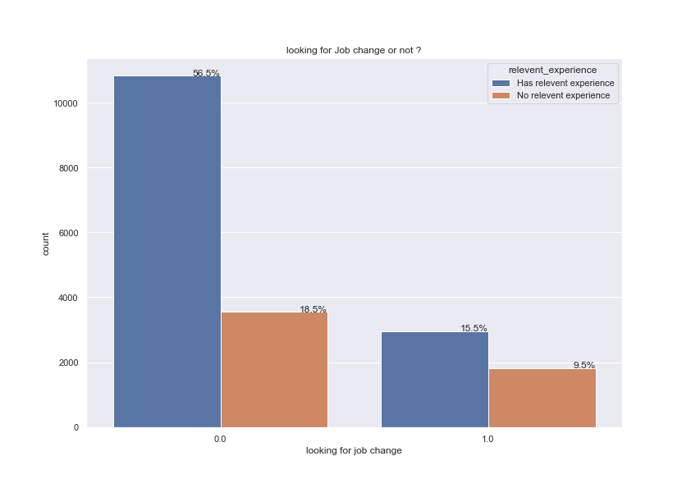
Data insights (Cont.)
Out of those who looks for job change, 15.5 % have relevent experience. this may happend a lot of people are who have experience more confident with their skills to looking for new job

Slide 10
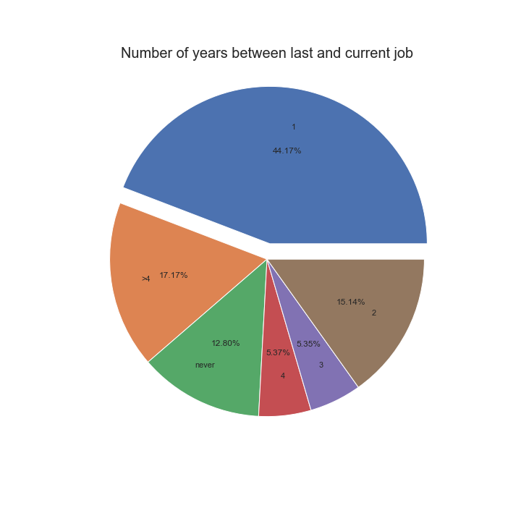
Data insights (Cont.)
We can see that poeple who looking for job change is have less than 1 year experience, this maybe happening because they find it uncomfortable to working on that company, so they try to find another company

Slide 11

Dashboard Homepage

Slide 12
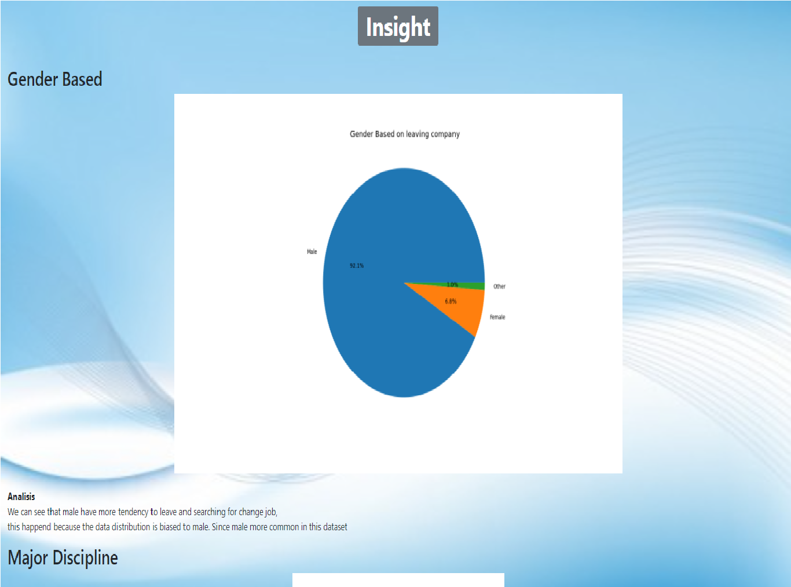
Dashboard Visualization

Slide 13
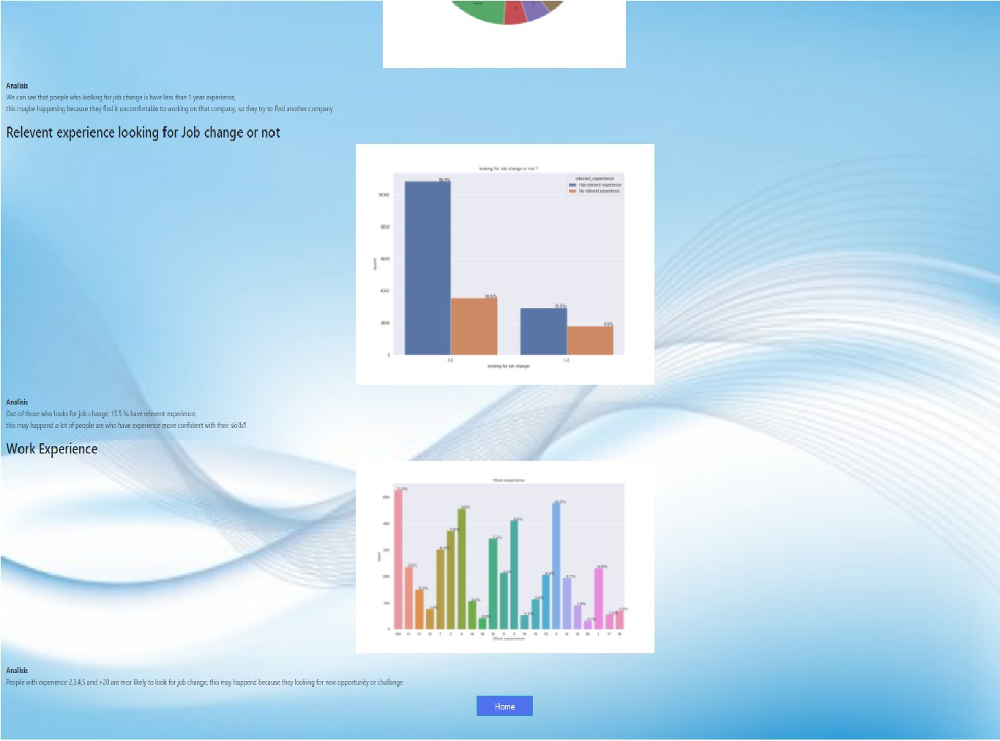
Visualization II

Slide 14
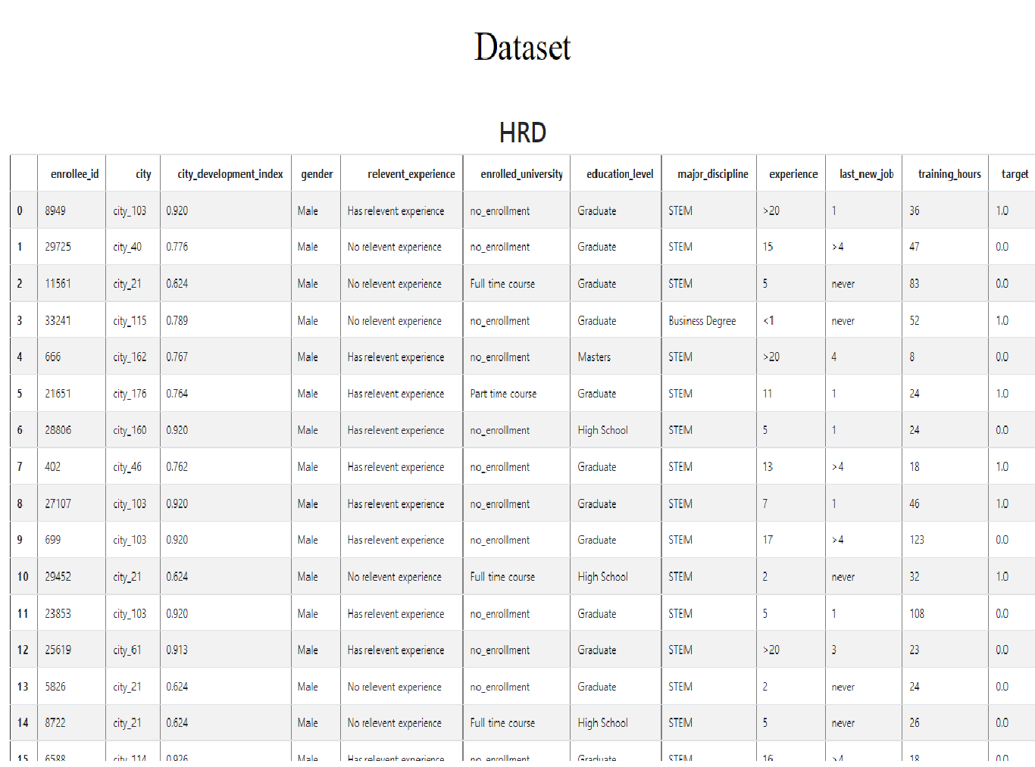
Dashboard Data Set

Slide 15
Visualization II

Slide 16


